Slide 1

UIU STUDENT ACTIVITY TRACKER

Slide 2
Team Members
Abtahi Ahmed
ID: 011202247
Kazi Shawpnil
ID: 011201125
Khaled Saifullah
ID: 011201195
Layla Kader Suma
ID: 011201137
Notes:
Notes to presenter:
Description of what you learned in your own words on one side.
Include information about the topic
Details about the topic will also be helpful here.
Tell the story of your learning experience. Just like a story there should always be a beginning, middle and an end.
On the other side, you can add a graphic that provides evidence of what you learned.
Feel free to use more than one slide to reflect upon your process. It also helps to add some video of your process.

Slide 3
Tools Of Information Gathering
We chose questionnaire to gather information because we could examine a large number of respondents at the same time.
We used Google Forms to create our questionnaire.
We also conducted some interviews with faculty members.
The mode was in-person interviews.
Notes:
Notes to presenter:
Description of what you learned in your own words on one side.
Include information about the topic
Details about the topic will also be helpful here.
Tell the story of your learning experience. Just like a story there should always be a beginning, middle and an end.
On the other side, you can add a graphic that provides evidence of what you learned.
Feel free to use more than one slide to reflect upon your process. It also helps to add some video of your process.

Slide 4
Demographics Of Our Questionnaire Respondents
A total of 103 people have responded to our survey until now.
Our respondents were male and female students, alumni and teachers of UIU.
Most of them were undergraduate students, however, we had some respondents with Honours, Masters and PhD degrees.
Notes:
Notes to presenter:
Description of what you learned in your own words on one side.
Include information about the topic
Details about the topic will also be helpful here.
Tell the story of your learning experience. Just like a story there should always be a beginning, middle and an end.
On the other side, you can add a graphic that provides evidence of what you learned.
Feel free to use more than one slide to reflect upon your process. It also helps to add some video of your process.

Slide 5

Survey Results
Notes:
Notes to presenter:
What is your purpose for sharing this reflection?
Is it at the end of a unit or project?
Are you sharing this reflection, at the attainment of a learning goal you set for yourself?
Is it at the end of a course?
State your purpose for the reflection or even the purpose of the learning experience or learning goal. Be clear and be specific in stating your purpose.

Slide 6
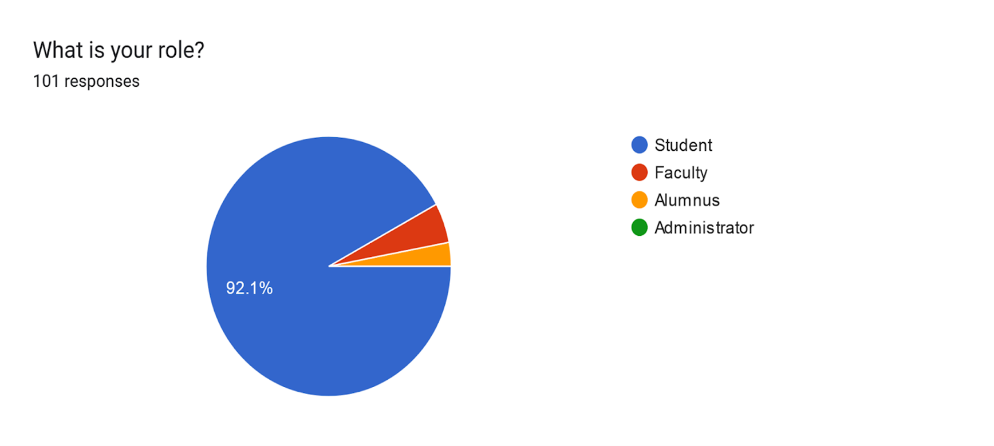
Question:1

Slide 7
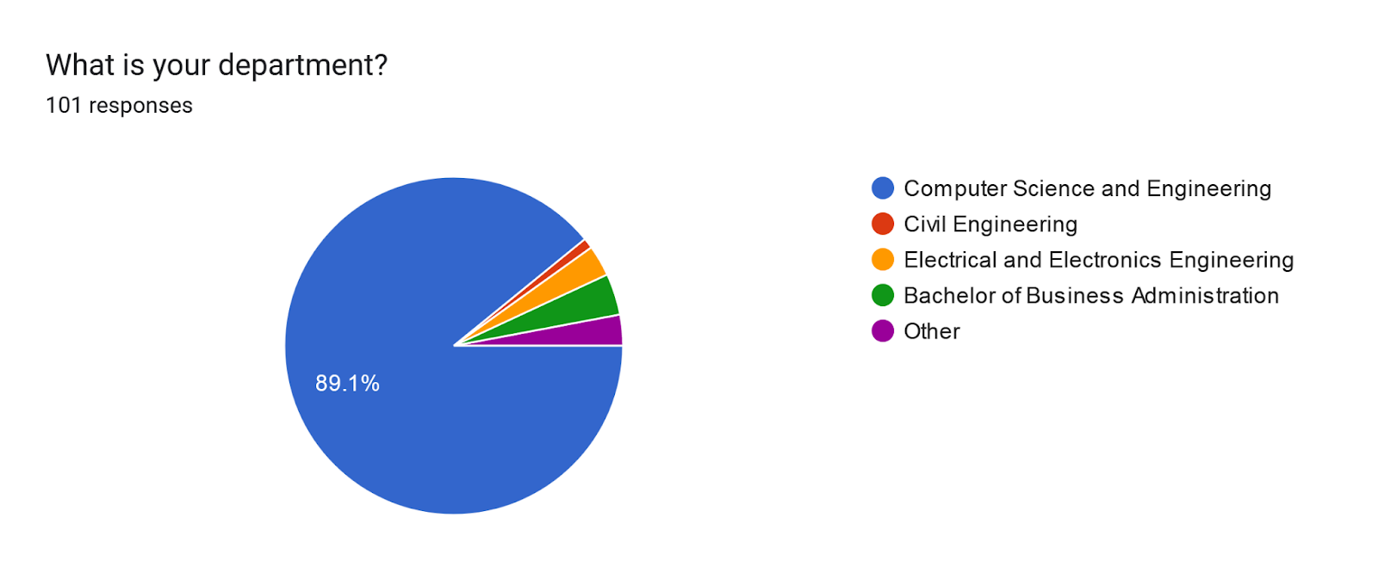
Question:2

Slide 8
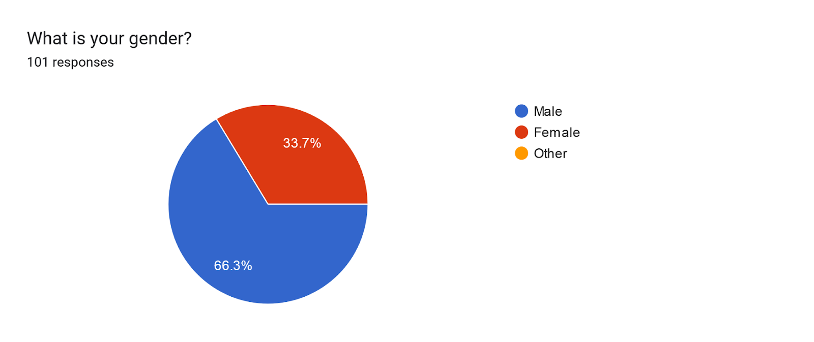
Question:3

Slide 9
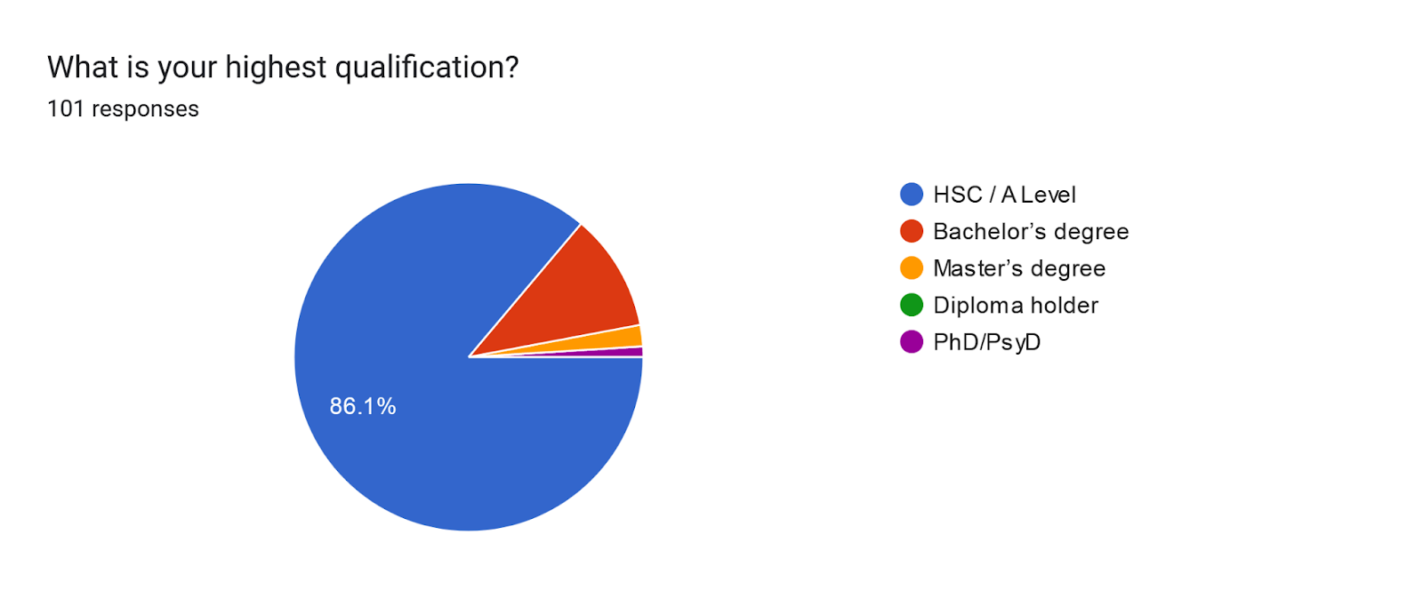
Question:4

Slide 10
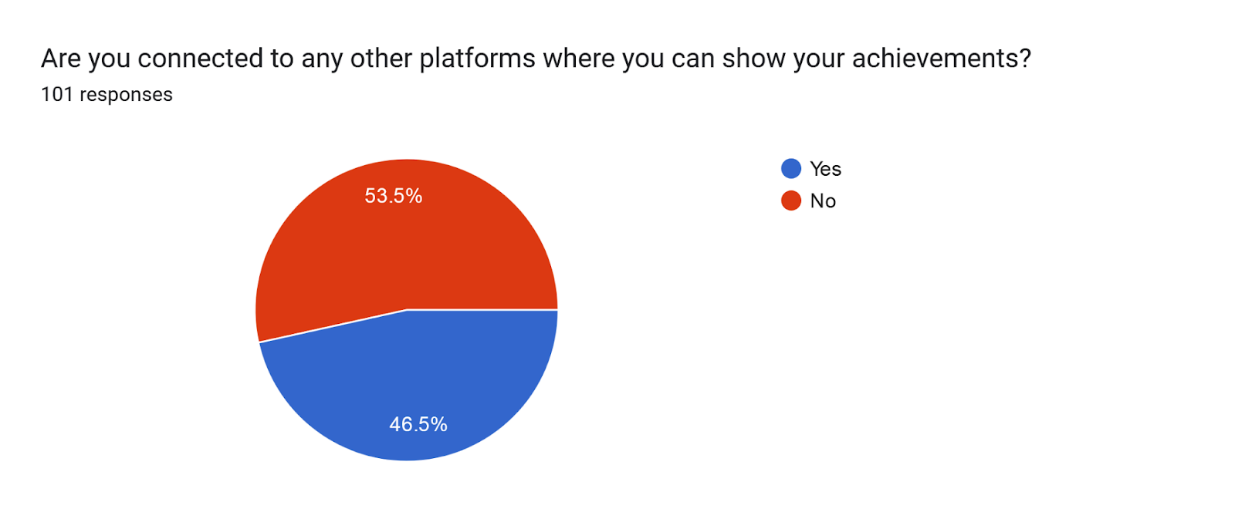
Question:5

Slide 11
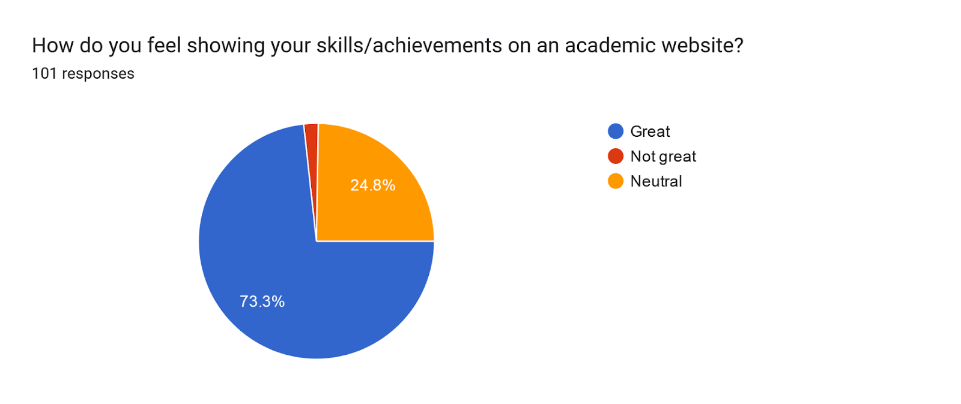
Question:6

Slide 12
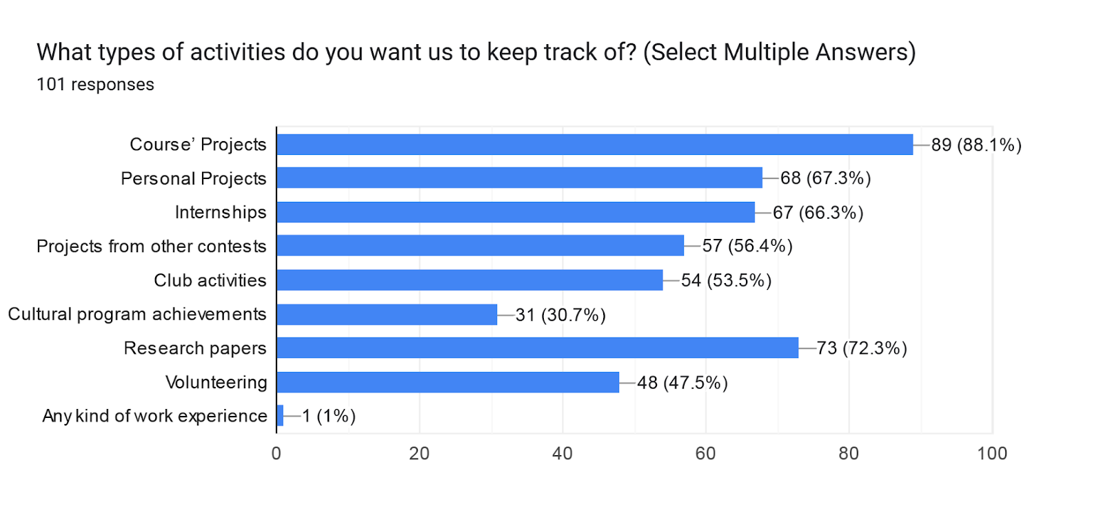
Question:7

Slide 13
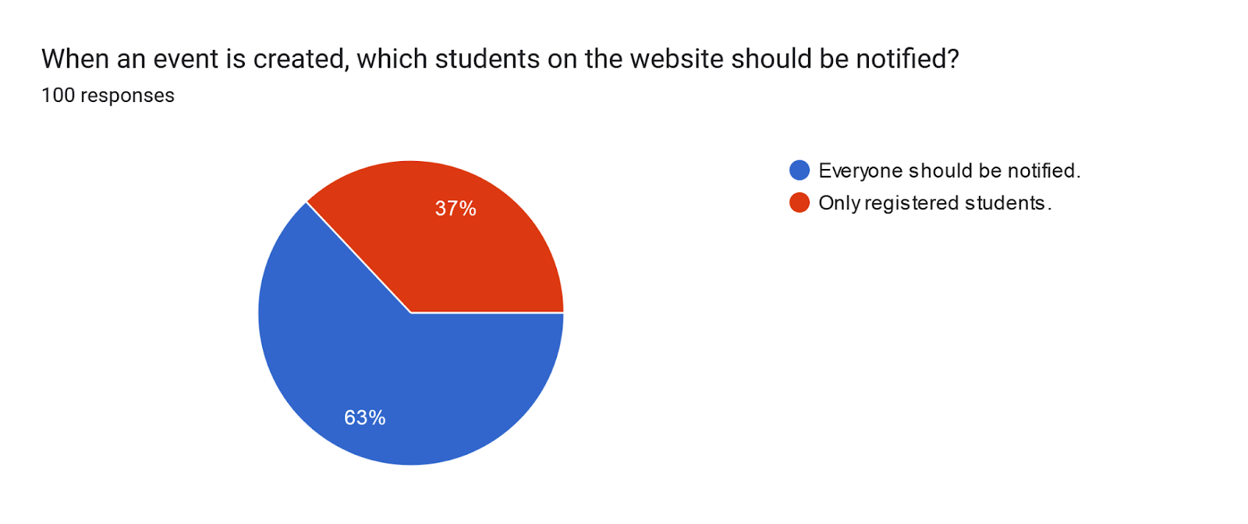

Question:8 Decision : We implement ‘Events’ feature
Notes:
Notes to presenter:
What did you think at first?
What obstacles did you encounter along the way?
How did you overcome those obstacles?
What images can you add to support your process?
This SmartArt allows you add images and text to help outline your process. If a picture is worth a thousand words, then pictures and words should help you communicate this reflection on learning perfectly! You can always click on Insert>SmartArt to change this graphic or select the graphic and click on the Design contextual menu to change the colors.
Feel free to use more than one slide to reflect upon your process. It also helps to add some video of your process.

Slide 14
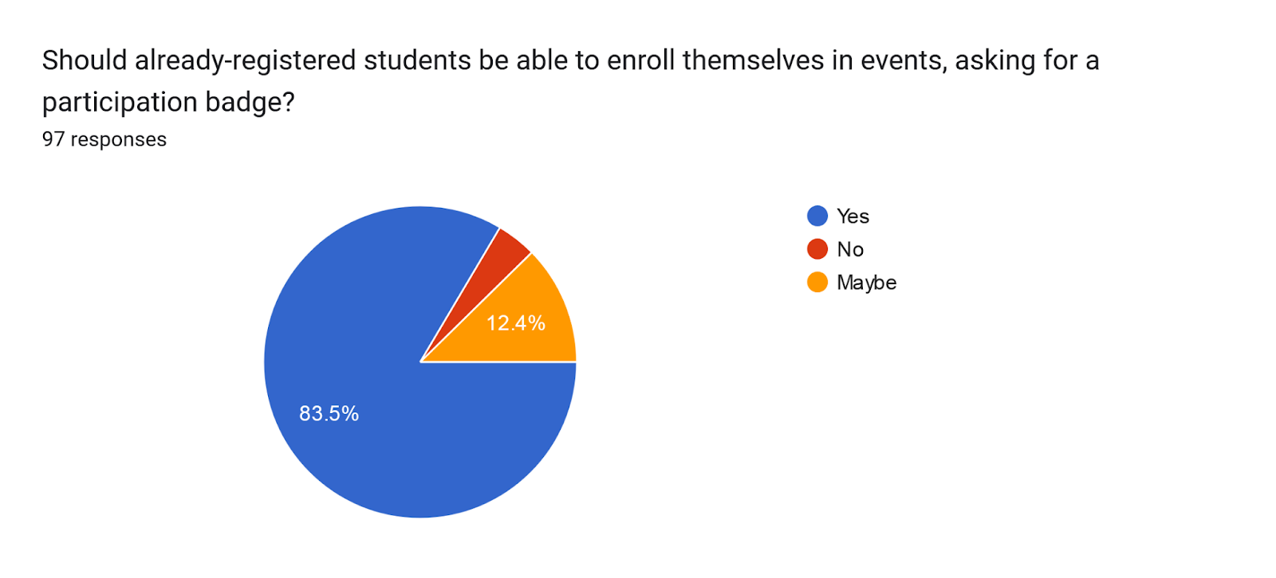
Question:9

Slide 15
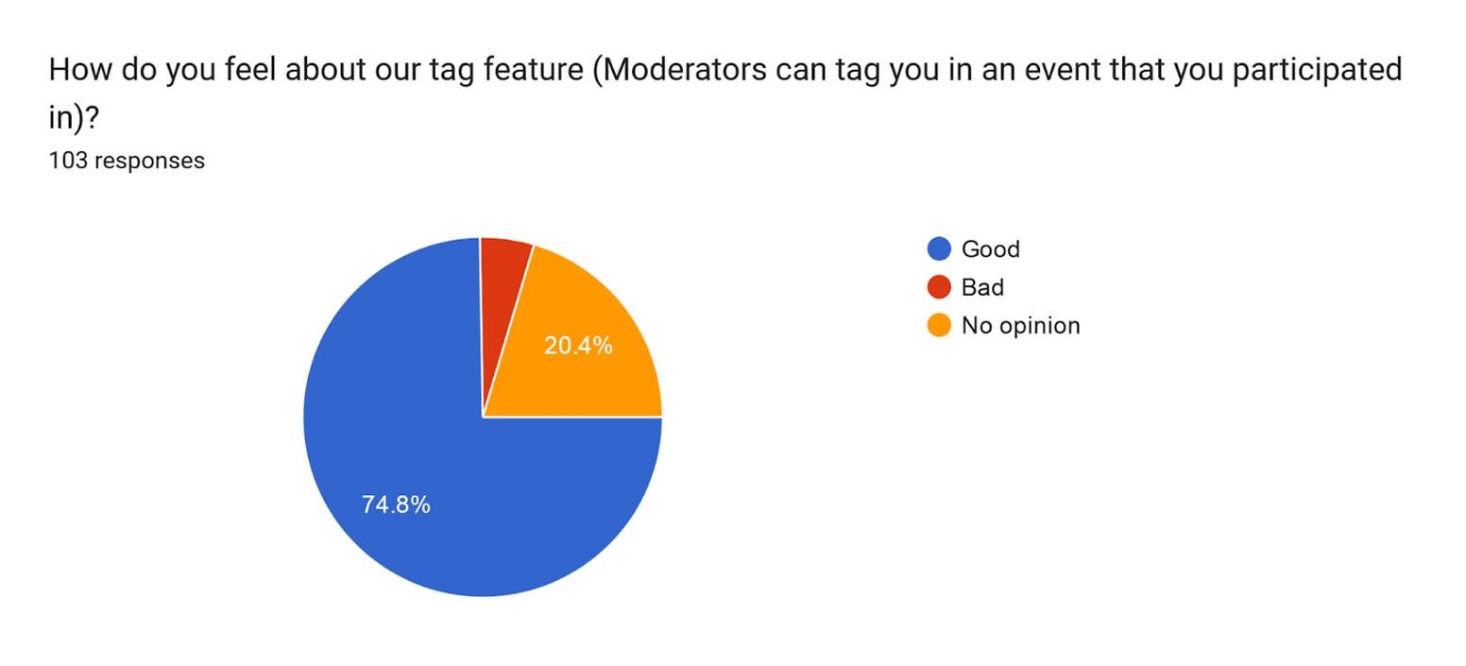
Question:10 Decision : We implement ‘Tag’ feature
Notes:
Notes to presenter:
What did you think at first?
What obstacles did you encounter along the way?
How did you overcome those obstacles?
What images can you add to support your process?
This SmartArt allows you add images and text to help outline your process. If a picture is worth a thousand words, then pictures and words should help you communicate this reflection on learning perfectly! You can always click on Insert>SmartArt to change this graphic or select the graphic and click on the Design contextual menu to change the colors.
Feel free to use more than one slide to reflect upon your process. It also helps to add some video of your process.

Slide 16
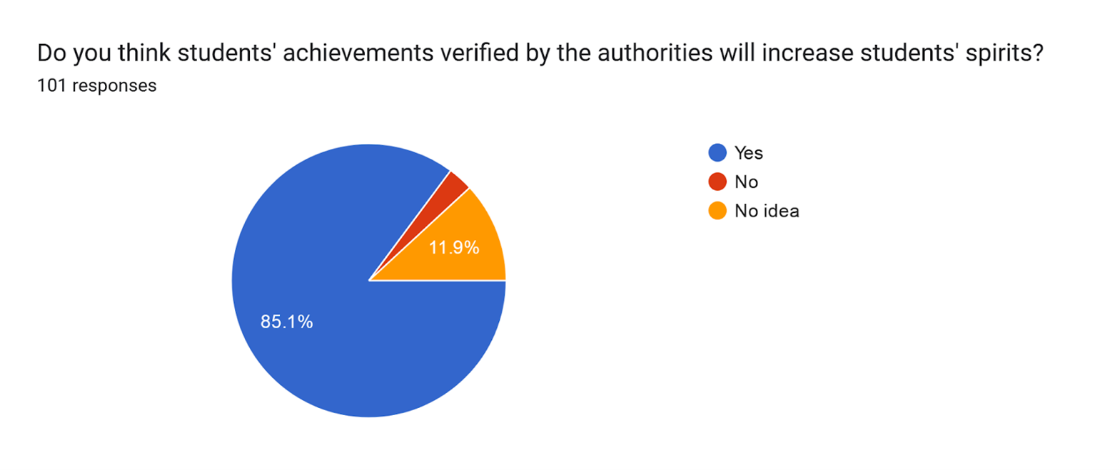
Question:11 Decision : We implement ‘Verification’ feature
Notes:
Notes to presenter:
What did you think at first?
What obstacles did you encounter along the way?
How did you overcome those obstacles?
What images can you add to support your process?
This SmartArt allows you add images and text to help outline your process. If a picture is worth a thousand words, then pictures and words should help you communicate this reflection on learning perfectly! You can always click on Insert>SmartArt to change this graphic or select the graphic and click on the Design contextual menu to change the colors.
Feel free to use more than one slide to reflect upon your process. It also helps to add some video of your process.

Slide 17
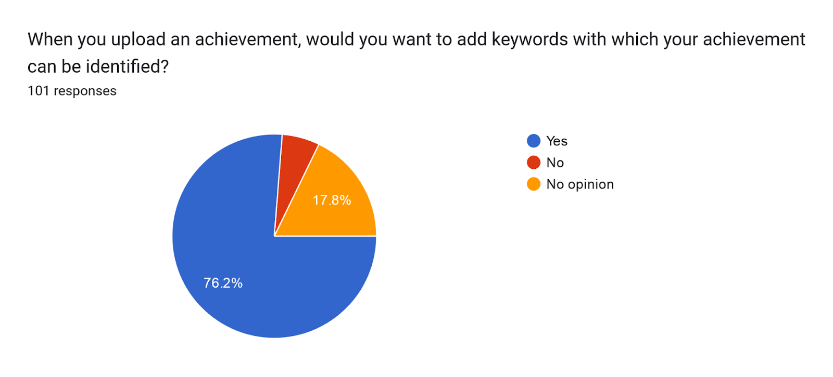
Question:12 Decision : We implement ‘Keywords’ feature
Notes:
Notes to presenter:
What did you think at first?
What obstacles did you encounter along the way?
How did you overcome those obstacles?
What images can you add to support your process?
This SmartArt allows you add images and text to help outline your process. If a picture is worth a thousand words, then pictures and words should help you communicate this reflection on learning perfectly! You can always click on Insert>SmartArt to change this graphic or select the graphic and click on the Design contextual menu to change the colors.
Feel free to use more than one slide to reflect upon your process. It also helps to add some video of your process.

Slide 18
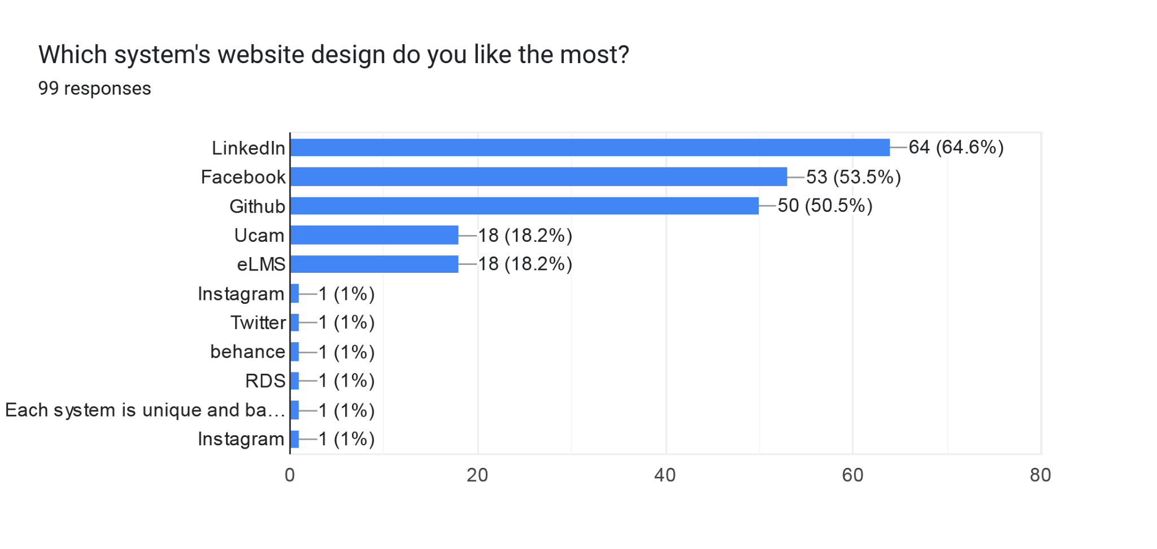
Question:13

Slide 19
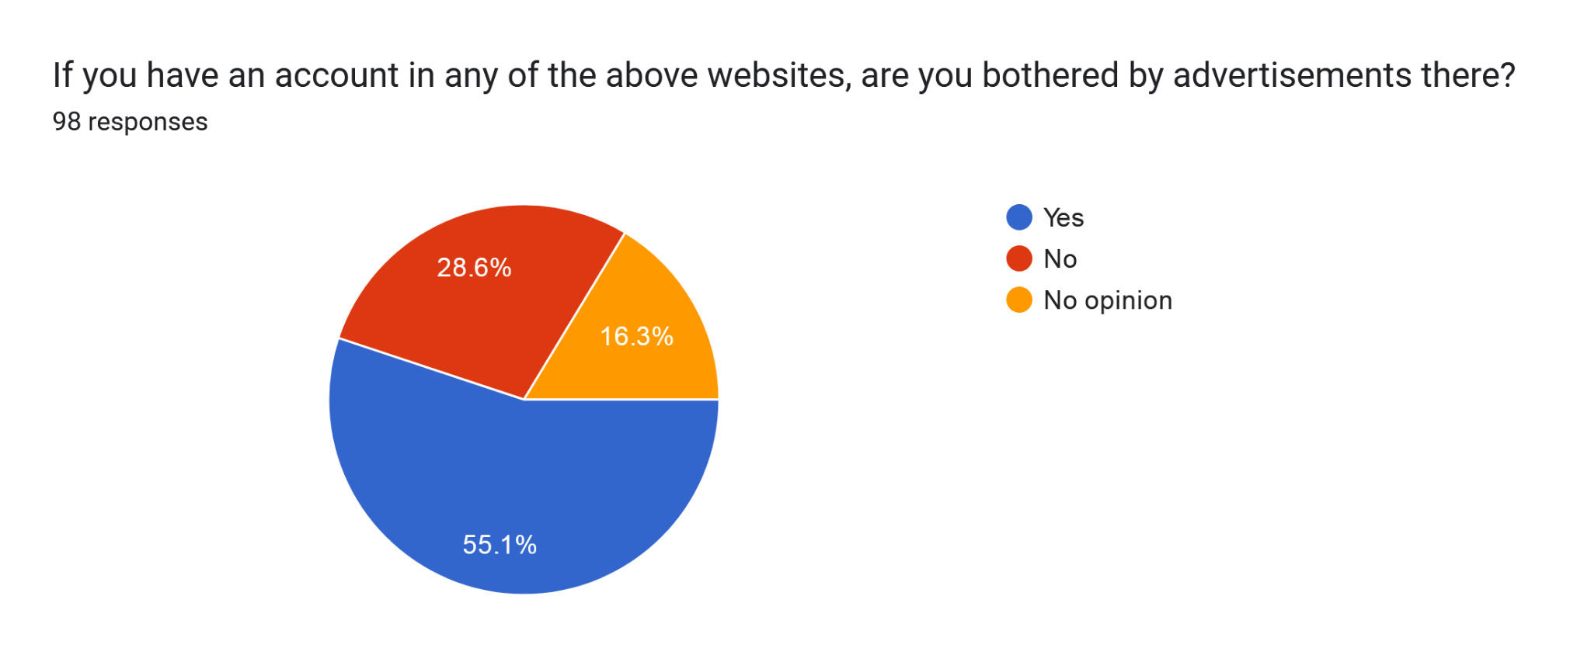
Question:14

Slide 20
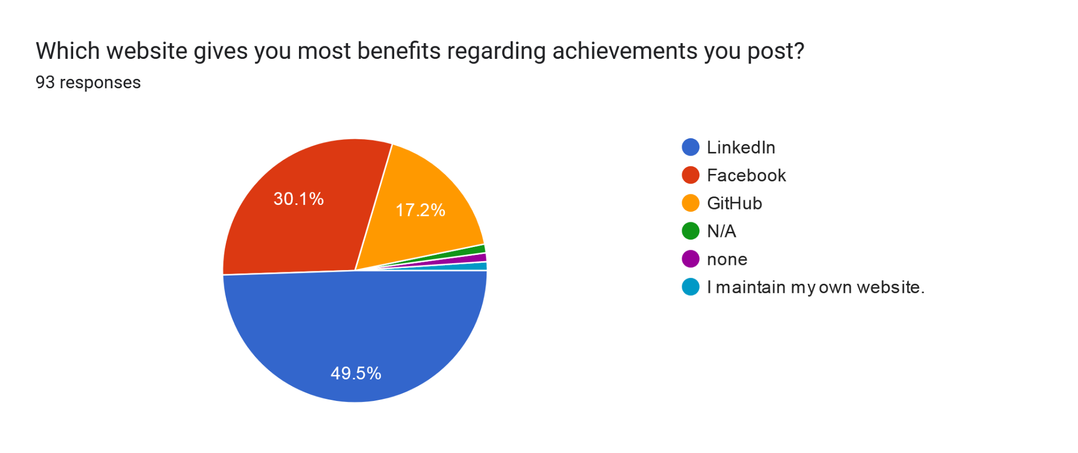
Question:15

Slide 21
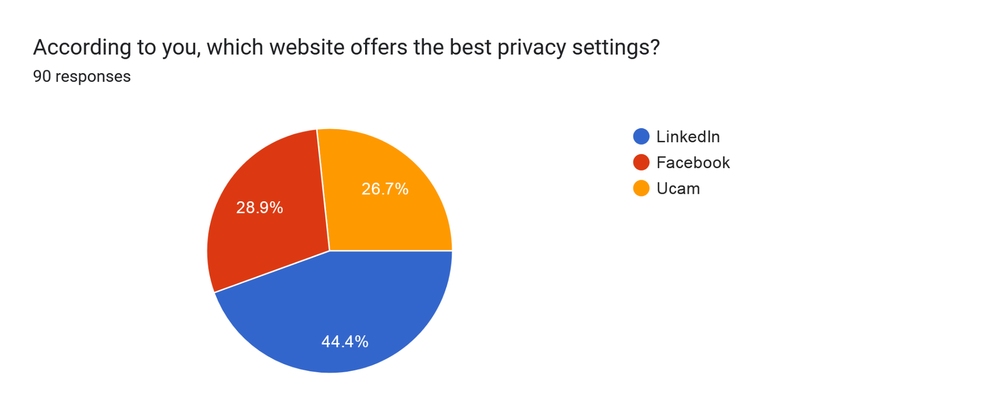
Question:16

Slide 22
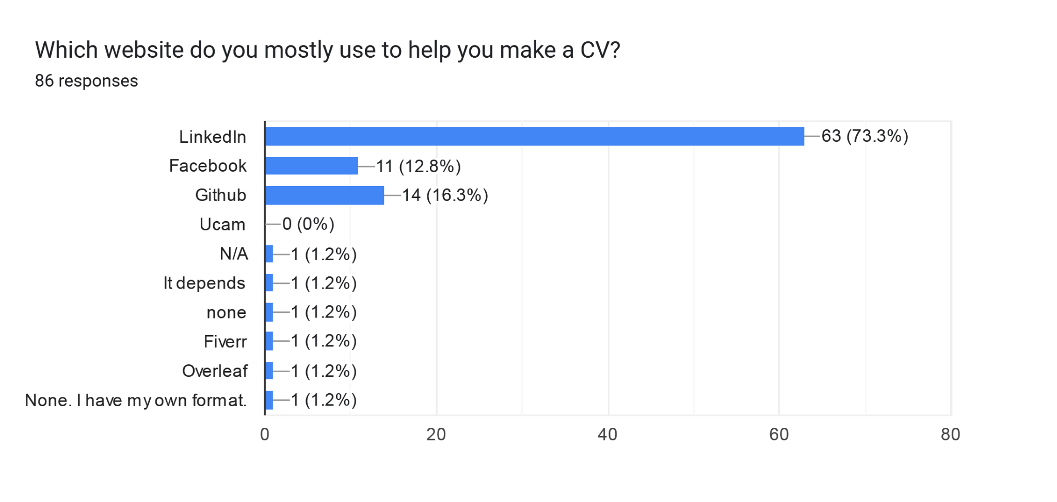
Question:17

Slide 23
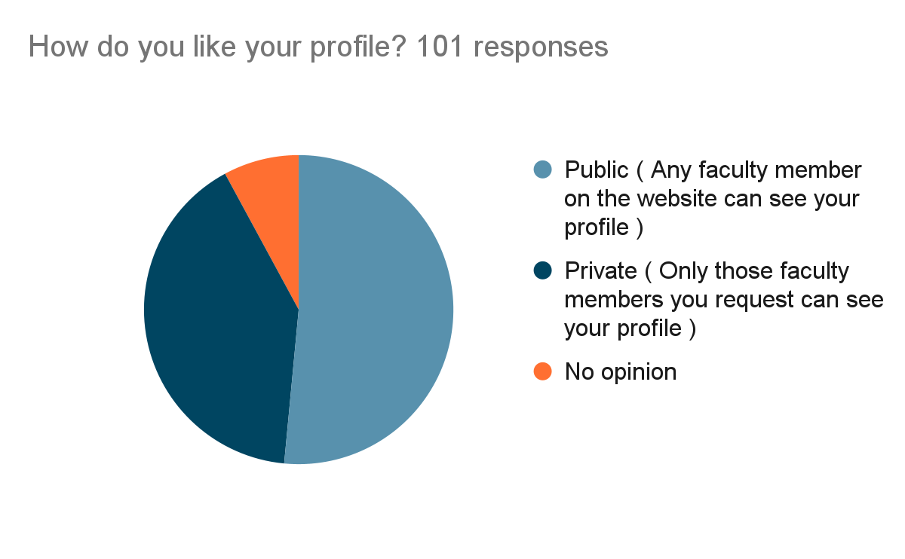
Question:18

Slide 24
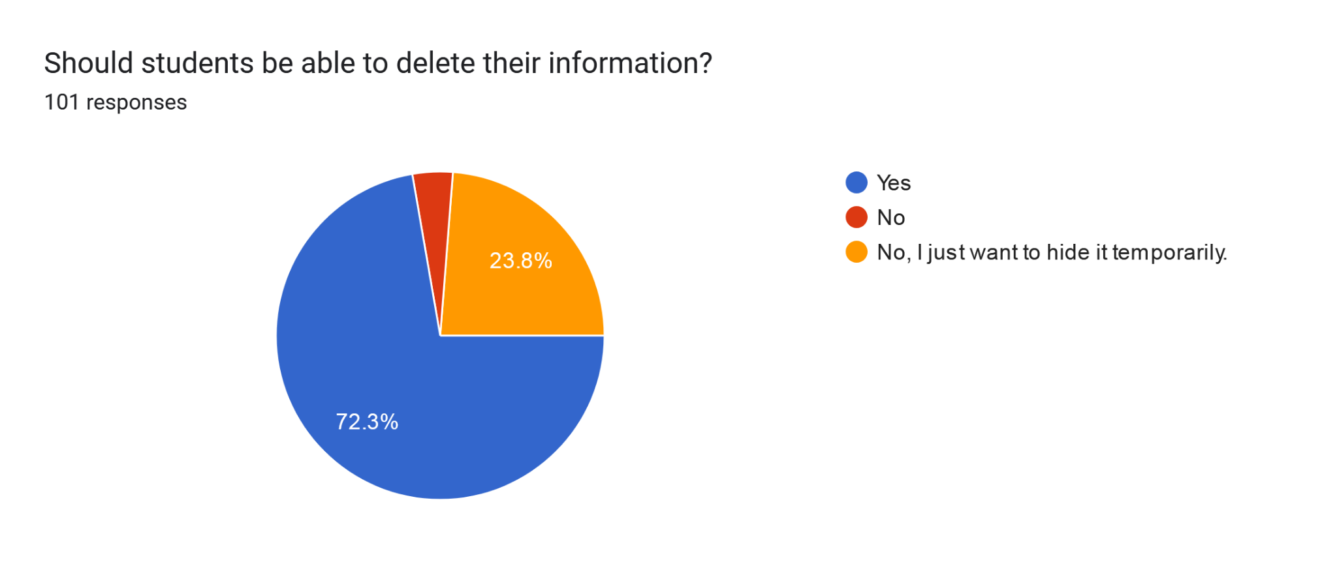
Question:19 Decision : We may implement ‘Delete’ feature
Notes:
Notes to presenter:
What did you think at first?
What obstacles did you encounter along the way?
How did you overcome those obstacles?
What images can you add to support your process?
This SmartArt allows you add images and text to help outline your process. If a picture is worth a thousand words, then pictures and words should help you communicate this reflection on learning perfectly! You can always click on Insert>SmartArt to change this graphic or select the graphic and click on the Design contextual menu to change the colors.
Feel free to use more than one slide to reflect upon your process. It also helps to add some video of your process.

Slide 25

Question:20

Slide 26
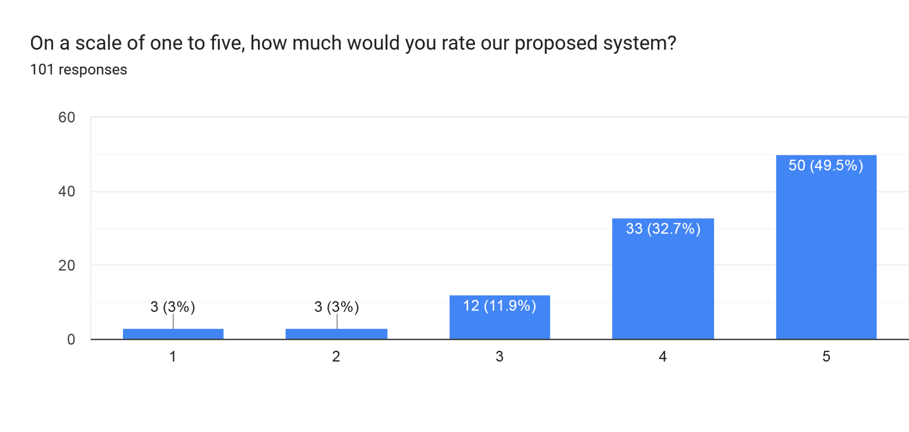
Question:21

Slide 27
Amount Of Responses In Favour Of Each Feature
Profile - 73% want this
Show Achievements - 73% want this
Events - 63% want this
Tag - 75% want this
Notification - 64% want this
Search - 76% want this
Achievement Verification - 85% want this
Data Control - 72% want to delete their information
Extra Feature - 41% want their profile to be private ( visible to only designated faculty members), so we might think about it.
All of the above proposed features have received positive feedback, so we are going to implement them all.
Notes:
Notes to presenter:
Description of what you learned in your own words on one side.
Include information about the topic
Details about the topic will also be helpful here.
Tell the story of your learning experience. Just like a story there should always be a beginning, middle and an end.
On the other side, you can add a graphic that provides evidence of what you learned.
Feel free to use more than one slide to reflect upon your process. It also helps to add some video of your process.

Slide 28
Summary Of In-Person Interviews
Notes:
Notes to presenter:
What is your purpose for sharing this reflection?
Is it at the end of a unit or project?
Are you sharing this reflection, at the attainment of a learning goal you set for yourself?
Is it at the end of a course?
State your purpose for the reflection or even the purpose of the learning experience or learning goal. Be clear and be specific in stating your purpose.

Slide 29
Interviewer Questions or Objectives | Interviewee Responses
Share your experience when you completed your graduation and made a CV for searching jobs? a. What are the problems you faced? b. What was your expectations c. Were you satisfied with your process? d. Do you want to change/develop your system? | No portfolio required Confusion on making different types of CV Forget the achievements No verification System should be changed
How do you feel about having a student’s achievements in UIU to be displayed on a website? | It will be a great opportunity for students and filtering them via CV.
What do you do when you want to attain records/achievements of a sports team or maybe records about a university, etc.? Follow-Up Which websites/apps do you visit most often to attain these records? | Searching in Google or the different sites according the topics. Do manual searching like, asking moderators or admins.
What website or data do you use when writing a recommendation letter? | Courses done under the supervision of the faculty looked into the student’s sincerity.
If you had all the achievements of a student stored in one place, would you use that information in any way? Follow-up How would you use that information? | TA and RA recruitment Filtering out students for different purposes Data analysis purpose Easy to make a recommendation Club members findings with good experiences

Slide 30
Interviewer Questions or Objectives | Interviewee Responses
Would you want achievements posted by students to be verified by someone trustworthy? (Verifying means manually checking individual achievements and giving them a tick maybe) Follow-Up Who do you think should verify students' achievements? | Yes, that’s a good way. The designated faculty member can verify students’ achievements. Project shows and other events can be verified by the host or DSA or CCC depending on the events. Need certificate to verify.
How would you feel if some student of yours asked you to verify a certain achievement? | Willingly, if possible, e-mail notification would be better.
There will be a search bar on our website. What kind of information would you like to search about on the website? | Filter out based on the requirement. Sub-categories can be helpful.
Is this project a great opportunity for students to gather their achievements in one frame? | Yes.
What do you think? How can we encourage students to use this site? | The benefited outcomes for storing data in one place Do registration in that website Get recruitment notices Can apply for TA or RA

Slide 31
SWOT Analysis
Notes:
Notes to presenter:
What is your purpose for sharing this reflection?
Is it at the end of a unit or project?
Are you sharing this reflection, at the attainment of a learning goal you set for yourself?
Is it at the end of a course?
State your purpose for the reflection or even the purpose of the learning experience or learning goal. Be clear and be specific in stating your purpose.

Slide 32
Strengths:
Weakness:
A new, easy-to-use product to showcase skills faster.
We know the problems we faced, so we can relate to the users.
Good, basic marketing plans.
We don’t have sufficient financial resources to participate in such project.
We don’t have enough experience to execute the project
Opportunities:
Threats:
Little to no competitors
Emerging need for the software due to more demand for displaying skills (that too easily)
We can easily get the human resources to build and maintain the software as the backend languages are common.
Security will a little weak due to programming language
Easy to replicate software

Slide 33
Strategy
As a new project, ours could be helpful for starters
for the UIU users. We would need more feedback to from potential users to develop our project well. If we study resources from the internet and take assistance from experienced developers, along with implementing a PHP framework and API, we can ensure a standard and secure project.

Slide 34
Do you have any question about this presentation?
Thank You
Notes:
Notes to presenter:
What is your purpose for sharing this reflection?
Is it at the end of a unit or project?
Are you sharing this reflection, at the attainment of a learning goal you set for yourself?
Is it at the end of a course?
State your purpose for the reflection or even the purpose of the learning experience or learning goal. Be clear and be specific in stating your purpose.

